Slide 1
Student &
Teacher Surveys
Mountain View Elementary School Library
Elisa Burggraf
LBSC 741

Slide 2
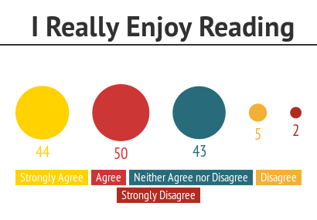
Student Survey Highlights
144 respondents
65.28 % of students strongly agree or agree with the statement
“I really enjoy reading.”

Slide 3
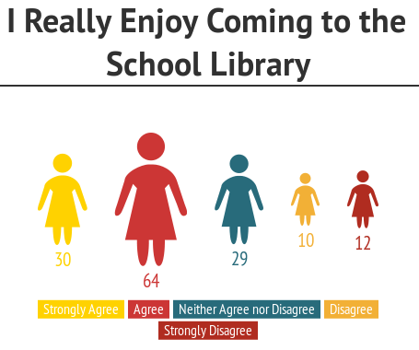
65.28 % of students strongly agree or agree with the statement “I really enjoy coming to the school library.”

Slide 4
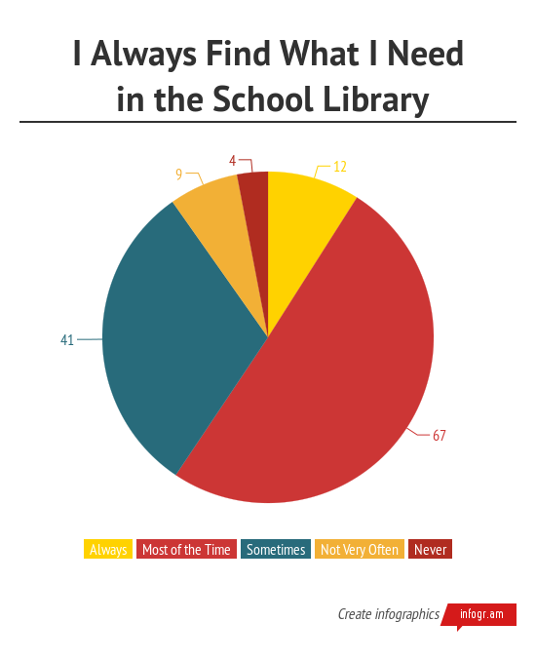
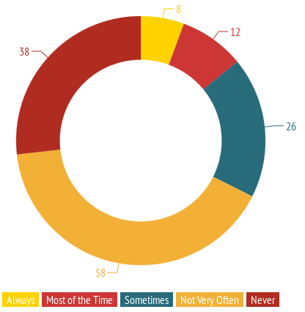
86% of students find what they need in the library and 66.67% of students report that they not often or never have to place a hold on the book they want to borrow.
I ALWAYS
have to put
the book
I want
on hold.

Slide 5
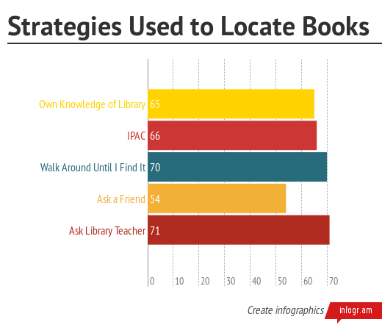
64.58% of students get the help they need in the library always or most of the time.
Students use many strategies to locate books; an average of 2.26 strategies per student.

Slide 6
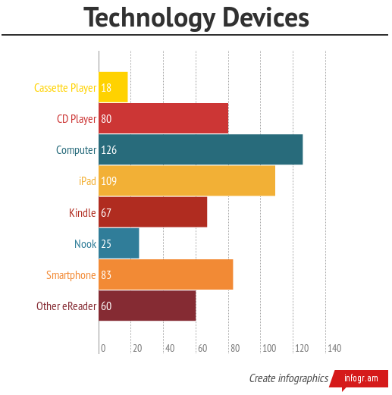
Most students have access to many technology devices at home.

Slide 7
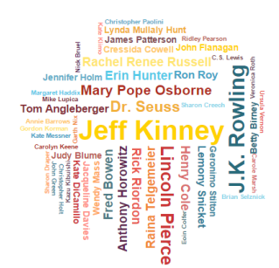
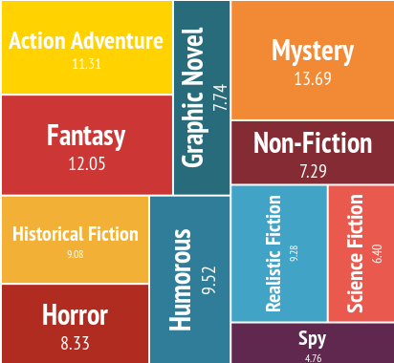
Students like to read many different genres and have many favorite authors. The three most liked genres are Action Adventure, Fantasy, and Mystery.
Hands down, Jeff Kinney
most favorite author.
Top 3 Favorite Authors:
Jeff Kinney
J.K. Rowling
Lincoln Pierce

Slide 8
What the students had to say:
“What is one thing about the library you would change?”
“What do you like best about the library?”
Top Three Answers:
Books (40.97%)
Library Staff (8.33%)
Quiet and Peaceful (6.94%)
Top Three Changes:
More (27.78%) – books (20.83%), computers
(3.47%), staff (.69%), size (2.78%)
Seating – comfortable chairs or bean bags
(6.94%)
Change organization (5.56%)
19.44% of students
reported that they would change NOTHING about
the library
Most delicious change suggested:
Serve hot chocolate and doughnuts

Slide 9
Teacher Surveys
22 responses

Slide 10
100% of teachers strongly agree or agree to the following statements:
Library staff helps teachers find and use resources.
The school library has helped my students find stories they like.
Library staff provides resources to support the curriculum.
Library staff responds to teachers’ requests for professional materials.
Library staff responds to teachers’ requests for student material.
Library staff lets teachers know about the resources available.
Library staff nurtures students love of reading.

Slide 11
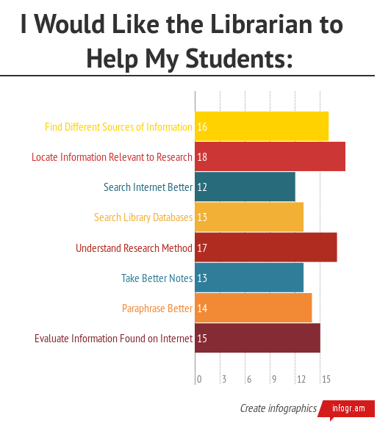
Top Three Skills Teachers Would like Librarian to Help Teach:
Locate Information Relevant to Research
Understanding the Research Method
Find Different Sources of Information

Slide 12
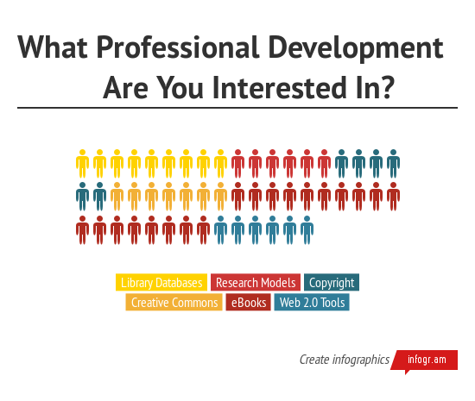
By a landslide, the topic that the most teachers would like to have training on is eBooks (81.82%)

Slide 13

Collaboration
Some of the inquiry units planned for this year are:
Ancient Civilizations
Poetry
Simple Machines
Animal Research
Sun
Famous Americans
13 of 22 teachers stated that Inquiry/discovery is an important part of my teaching practices (59.09%)
Greatest obstacle and aid to collaboration is – TIME. 7 teachers answered “time” to the question “How can we make collaboration work for you?”

Slide 14
What the teachers had to say:
“What are the strengths
of our library?”
“What could we do better?”
Staff (68.18%)
Collection (13.64%)
Collaboration (9.09%)
More technology
Increase size of collection
More teaching on research
Feature a professional resource at Lunch in the Library
“What are the gaps
or needs?”
Help reluctant readers
Let younger kids check out books other than board books
More high frequency word books
More copies of books we use as a grade level

Slide 15
Last question on survey:
“Anything else you would like to add?”
Responses:
“Thank you so much for always helping us find books to support our units. Thank you for lunch in the library.”
“It's a cozy friendly library!”
“We really enjoy storytime with audience participation and fingerplays/songs. Thank you!”
“I need to do a better job of letting the library staff know of my kids' reading levels. They are always willing to help them find "just right" books!”
“You Rock girls!!”
“We feel we can go to you and ask for anything, and you'll go above and beyond to make it.”

